Slide 1
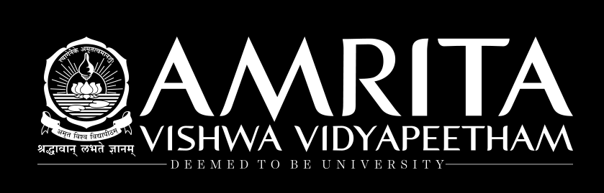
END SEM PRESENTATION
on
DRONE INTRUSION DETECTION USING DEEP LEARNING TECHNIUES
Team Members
B.SAI ABHISHEK BL.EN.U4AIE21015
B.RUCHITH BALAJI BL.EN.U4AIE21017
CHILLAKURU HARI BL.EN.U4AIE21038
Date:23/05/24
Course :DLSIP
Rimjhim Ma’am
AI 6th Sem –E Sec

Slide 2
CONTENTS
Problem statement
Introduction
Dataset description
Implementation
Results
Conclusion

Slide 3
PROBLEM STATEMENT
The problem Statement is to develop a Drone Intrusion detection model using deep learning techniques.
The goal is to build a scalable and efficient solution that incorporates advanced techniques to detect Drone Intrusion
Challenges:
Data Collection.
Choosing a Model.
Maintaining Efficiency.
Fine tuning.

Slide 4
INTRODUCTION
In the world's effort to ensure security, we face a significant challenge: detecting unauthorized drone intrusions that threaten sensitive areas.​
Traditional methods of identifying these intrusions involve a lot of time and hard work. ​
So, in this study, we're exploring a new solution – using advanced computer programs that learn from images of drones in restricted airspaces.​
Our goal is to make security measures more efficient and help authorities protect their areas better.

Slide 5
INTRODUCTION
In our effort to protect sensitive areas from unauthorized drone intrusions, we're using a smart technology called deep learning.​
It's like teaching computers to recognize when drones enter restricted airspace by showing them lots of images. ​
With deep learning techniques, computers can quickly and accurately spot intrusions, helping authorities take action sooner to ensure security.​

Slide 6
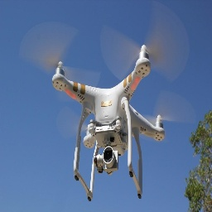
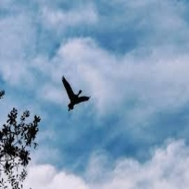
DATASET DESCRIPTION
Types of flying objects in Dataset :
Drones:
Drones pose security risks in restricted areas, necessitating swift detection and response to ensure safety and privacy in sensitive areas.
Birds:
Birds can sometimes be mistaken for drones, complicating the detection process in restricted airspaces. Differentiating between birds and drones accurately is essential to ensure reliable and effective intrusion detection..

Slide 7
DATASET DESCRIPTION
Our Dataset contains 4200 images of Drones and Bird Images:
Drones – 2100 images
Birds – 2100 images
Training: Validation: Testing = 60:20:20
Class | Training | Val | Testing
Drones | 1300 | 400 | 400
Birds | 1300 | 400 | 400

Slide 8
IMPLEMENTATION
Data Preprocessing:
Split the dataset into training, validation and testing sets.
Resize the images to a consistent size (e.g., 256x256 pixels).
zoom_range=0.2
shear_range=0.2
Model Selection:
We have chosen 1) CNN 2) ResNet 3) DenseNet 4) InceptionV3 model at beginning.
After the training, based on the Training and Validation metrics, Inception model performance is better than other models.
We have decided to choose InceptionV3 deep learning model as a base model and add attention layers to it to improve the metrics.

Slide 9
IMPLEMENTATION - Architecture
MODEL | ARCHITECTURE
CNN | model.add(Conv2D(32, (3, 3), input_shape=(img_width, img_height, 3), activation='relu')) model.add(MaxPooling2D(pool_size=(2, 2))) model.add(Conv2D(64, (3, 3), activation='relu')) model.add(MaxPooling2D(pool_size=(2, 2))) model.add(Conv2D(128, (3, 3), activation='relu')) model.add(MaxPooling2D(pool_size=(2, 2))) model.add(Flatten()) model.add(Dense(128, activation='relu')) model.add(Dense(train_generator.num_classes, activation='softmax'))
RESNET | x = base_model.output x = GlobalAveragePooling2D()(x) x = Dense(1024, activation='relu')(x) x = Dense(512, activation='relu')(x) # Added layer x = Dropout(0.5)(x) predictions = Dense(2, activation='softmax')(x)

Slide 10
IMPLEMENTATION - Architecture
MODEL | ARCHITECTURE
DENSENET | x = GlobalAveragePooling2D()(x) x = Dense(1024, activation='relu')(x) x = Dense(512, activation='relu')(x) x = Dropout(0.5)(x) # Added Dropout layer x = Dense(256, activation='relu')(x) x = Dropout(0.5)(x) # Added Dropout layer predictions = Dense(2, activation='softmax')(x)
INCEPTION | x = GlobalAveragePooling2D()(x) x = Dense(1024,activation='relu')(x) x = Dense(1024,activation='relu')(x) x = Dense(512,activation='relu')(x) x = Dense(2,activation = 'softmax')(x)

Slide 11
IMPLEMENTATION – Intermediate Results
Model | Acc | Pre | F1 | Rec
CNN | 93.4 | 89.95 | 93.02 | 94.02
DENSENET | 94.41 | 87.89 | 95.12 | 94.42
RESNET | 93.46 | 89.66 | 93.89 | 90.79
INCEPTION | 96.83 | 94.77 | 96.94 | 84.94
Model | Loss | Acc | Val_L | Val_acc
CNN | 0.2357 | 0.8981 | 0.5635 | 0.7789
DENSENET | 0.0273 | 0.9950 | 0.2599 | 0.8953
RESNET | 0.4349 | 0.8171 | 0.4972 | 0.7708
INCEPTION | 0.0141 | 0.9322 | 0.1784 | 0.9296
After the training, based on the Training and Validation metrics Inception model performance is better than other models.
We have decided to choose InceptionV3 deep learning model as a base model and add attention layers to it to improve the metrics.

Slide 12
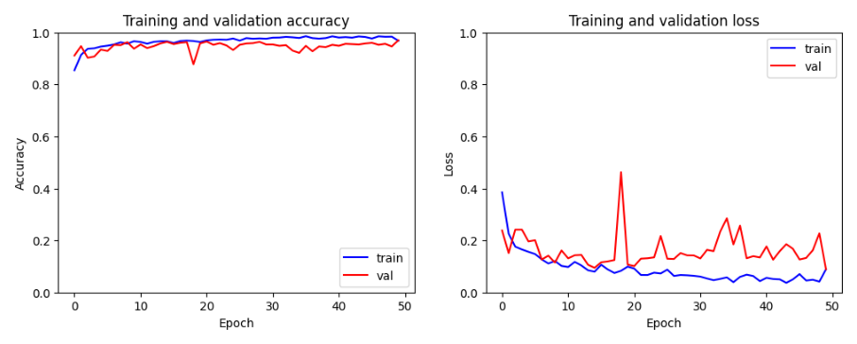
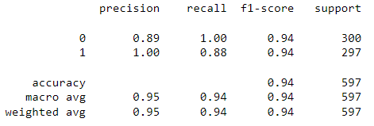
IMPLEMENTATION
GlobalAveragePooling2D
Dense(1024, activation = ‘relu’)
Dense(1024, activation = ‘relu’)
Dense(512, activation = ‘relu’)
Dense(2, activation = ‘softmax’)

Slide 13
IMPLEMENTATION
Fine Tuning:
Multi-head attention is a mechanism used in transformer-based architectures to capture diverse relationships and dependencies within input sequences by employing multiple parallel attention heads.​
Each attention head learns a different attention pattern by independently computing attention scores for projected query, key, and value vectors. ​
num_heads : Defines the number of parallel attention heads in the model. More heads allow the model to capture diverse patterns in the input data, enhancing performance but increasing computational complexity.​
key_dim: Sets the size of key and value vectors in each attention head. It balances the detail of captured information and computational efficiency, typically ranging from 64 to 512. The optimal size depends on the task's complexity and available resources.​

Slide 14
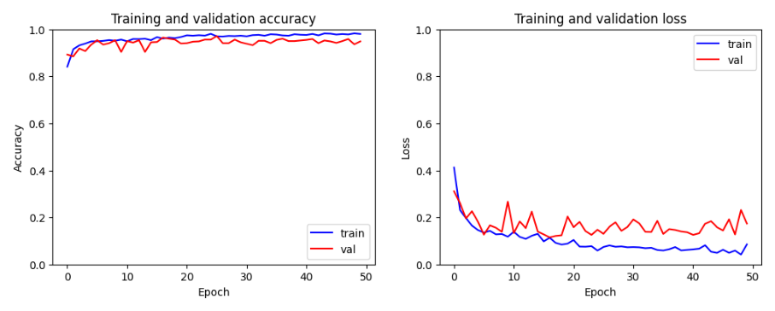
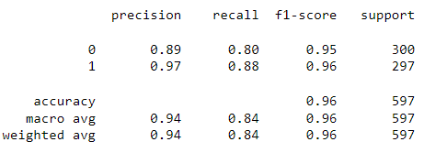
RESULTS
GlobalAveragePooling2D
Dense(1024, activation = ‘relu’)
MultiHeadAttention(num_heads = 8, key_dim = 64)
Dense(1024, activation = ‘relu’)
Dense(512, activation = ‘relu’)
Dense(2, activation = ‘softmax’)

Slide 15
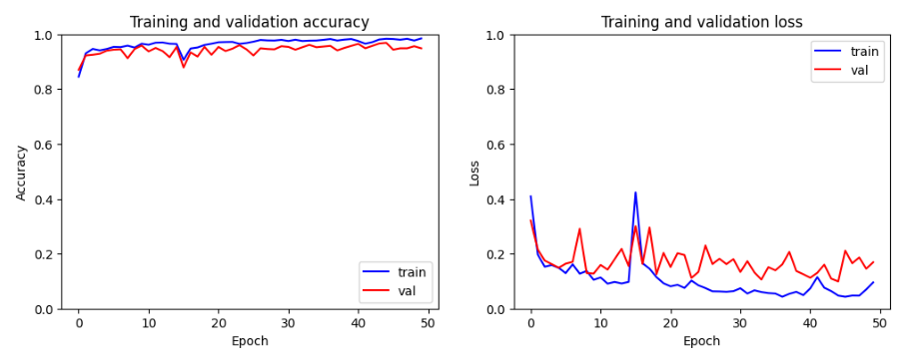
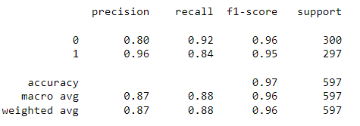
RESULTS
GlobalAveragePooling2D
Dense(1024, activation = ‘relu’)
Dense(1024, activation = ‘relu’)
MultiHeadAttention(num_heads = 8, key_dim = 64)
Dense(512, activation = ‘relu’)
Dense(2, activation = ‘softmax’)

Slide 16
RESULTS
Models | Accuracy
 | Train | Val | Test
Inception | 93.22 | 85.11 | 96.83
Inception (Layer 1) | 95.05 | 94.27 | 96.00
Inception (Layer 2) | 96.88 | 98.99 | 97.00
Model | Acc | Pre | F1 | Rec
Inception | 96.83 | 94.77 | 96.94 | 84.94
Inception (Layer 1) | 96.00 | 94.00 | 96.00 | 84.00
Inception (Layer 2) | 97.00 | 87.00 | 96.00 | 88.00

Slide 17
CONCLUSION
Using Inception with extra layers and self-attention mechanisms greatly improved our ability to detect drone Intrusion. ​
This enhanced model helps farmers identify intrusion correctly, leading to maintain better security, demonstrating the value of advanced AI techniques in security.​
In the future, we want to use our improved model to detect intrusion in more types of flying objects in air, create systems that alert officials right away about intrusion.

Slide 18
Thank You

